Slide 1
U-NET
FOR SEMANTIC SEGMENTATION

Slide 2
Topics to be covered
Semantic Segmentation
Transposed Convolution
U-Net Architecture

Slide 3
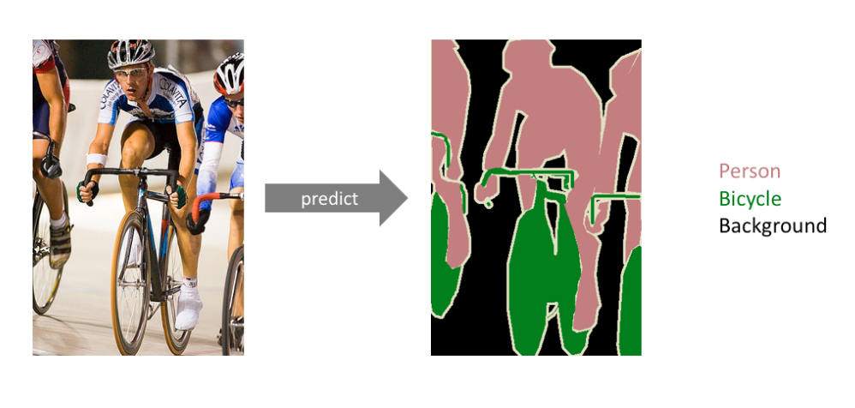
Semantic Segmentation

Slide 4
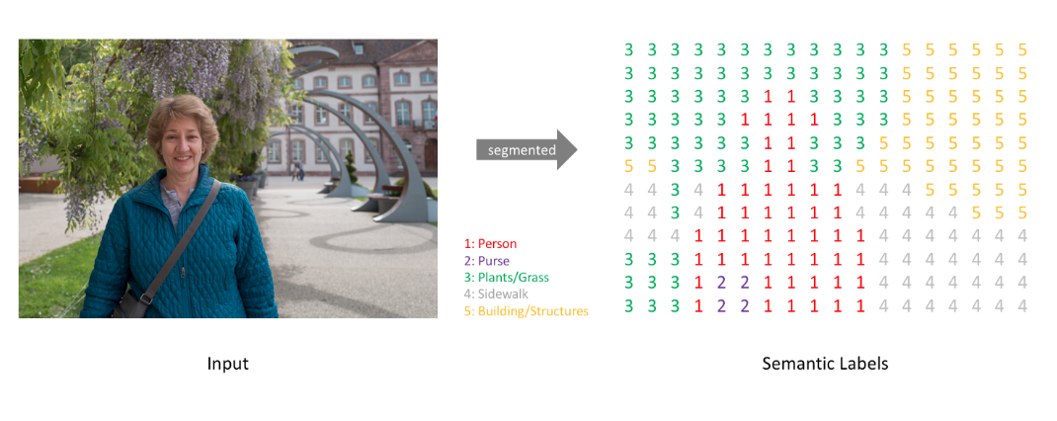
Semantic Segmentation

Slide 5
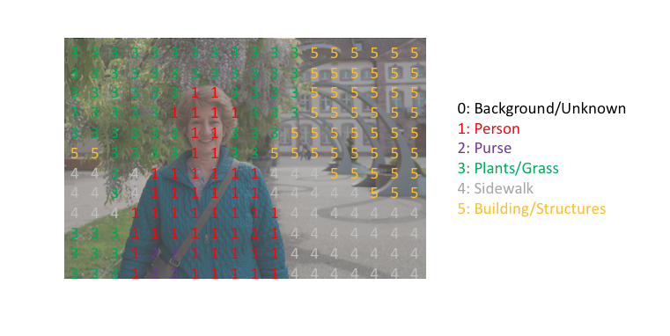
Semantic Segmentation

Slide 6
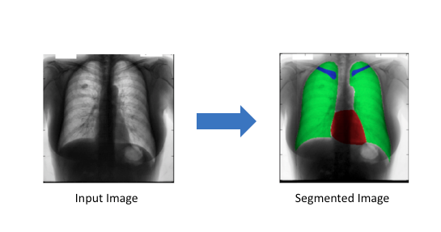
Semantic Segmentation
Applications

Slide 7
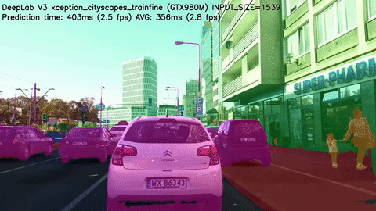
Semantic Segmentation
Applications

Slide 8
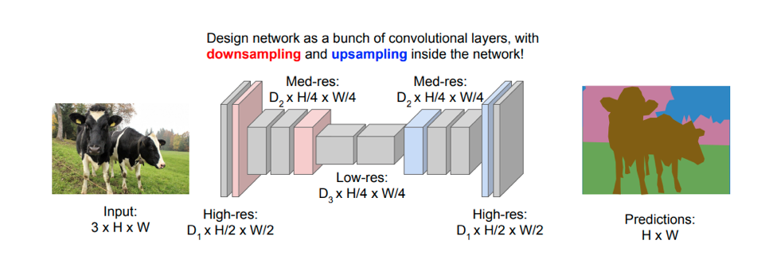
Semantic Segmentation
Approach

Slide 9
How can we perform UPSAMPLING?

Slide 10
How can we perform UPSAMPLING?
Interpolation

Slide 11
Interpolation
Nearest-Neighbor Interpolation
Bi-linear Interpolation
Bi-cubic Interpolation

Slide 12
Interpolation
Nearest-Neighbor Interpolation
Bi-linear Interpolation
Bi-cubic Interpolation
What’s the problem with interpolation in case of CNNs?

Slide 13
Interpolation
Nearest-Neighbor Interpolation
Bi-linear Interpolation
Bi-cubic Interpolation
What’s the problem with interpolation in case of CNNs?
We have to manually choose the type of interpolation, and we can’t
apply feature engineering here. The interpolation is not learnable.

Slide 14
How can we learn this UPSAMPLING?

Slide 15
How can we learn this UPSAMPLING?
Transposed Convolution

Slide 16
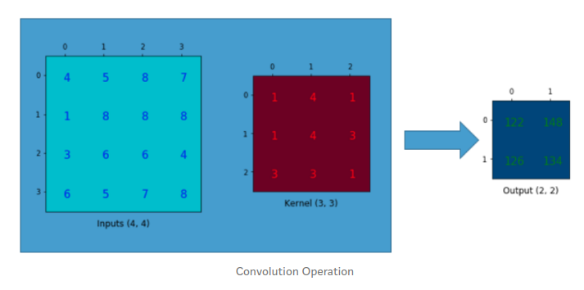
Convolution

Slide 17
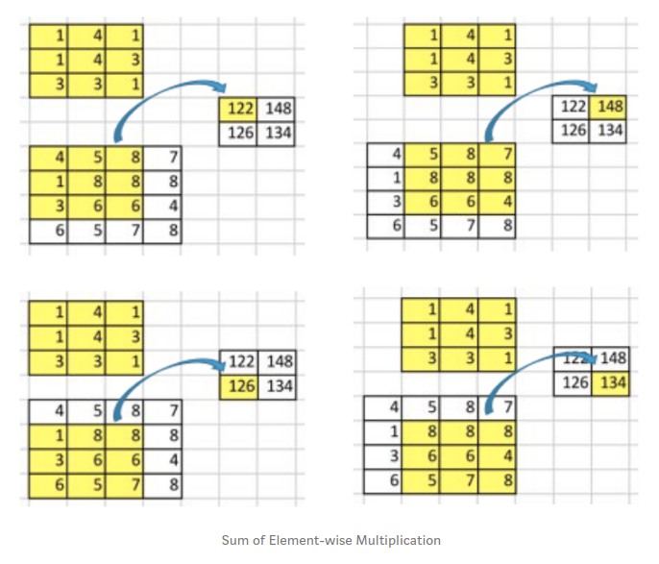
Convolution : Many-to-One

Slide 18
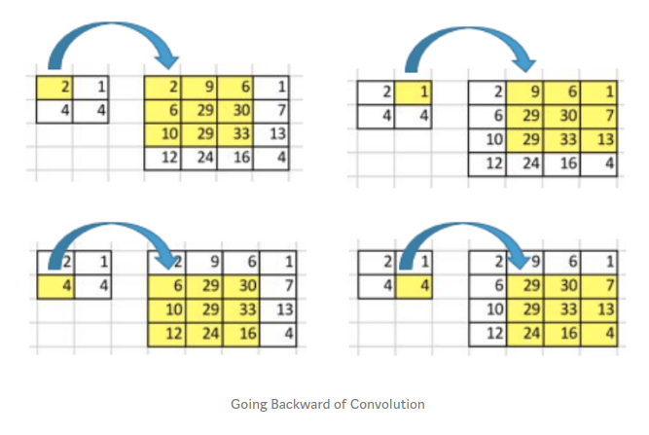
Backward Convolution : One-to-Many

Slide 19
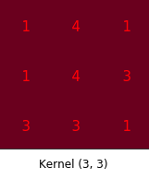
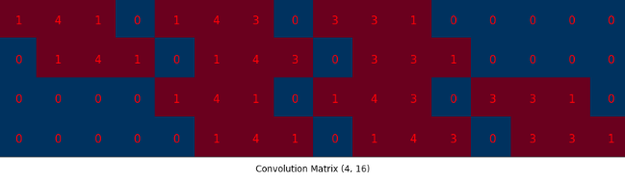
Convolution Matrix
We converted 3x3 kernel into 4x16 matrix

Slide 20
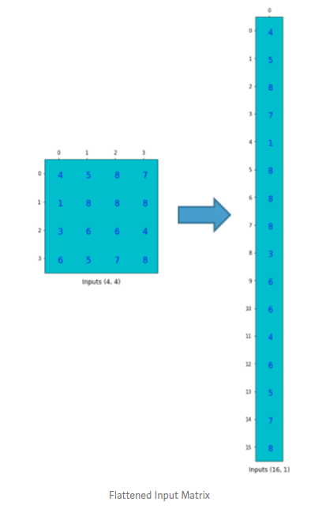
Convolution Matrix
We flattened 4x4 input to 16x1 vector

Slide 21
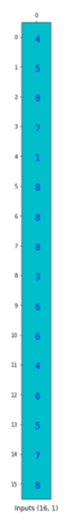
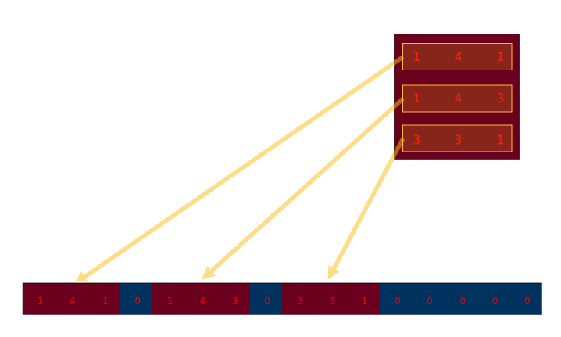
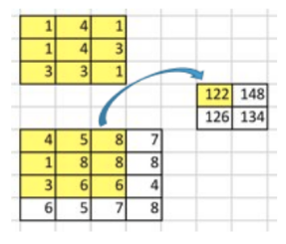
Convolution Matrix

Slide 22
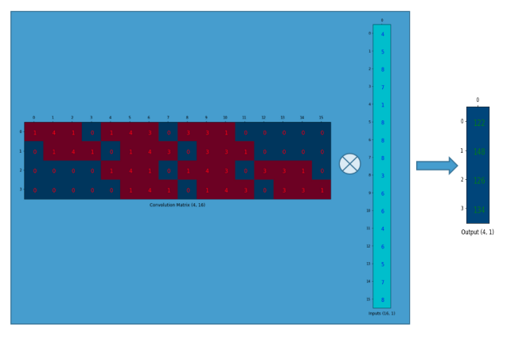
Convolution Matrix

Slide 23
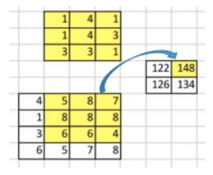
Convolution Matrix

Slide 24
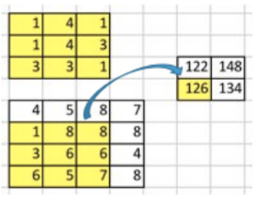
Convolution Matrix

Slide 25
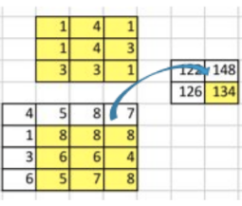
Convolution Matrix

Slide 26
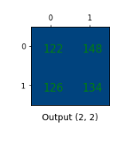
Convolution Matrix
We can convert 16x1 (4x4) input to 4x1 (2x2) output using 4x16 convolution matrix.
So, we can also convert 4x1 (2x2) input to 16x1 (4x4) output using 16x4 ‘transposed’ convolution matrix.
Let’s visualize.

Slide 27
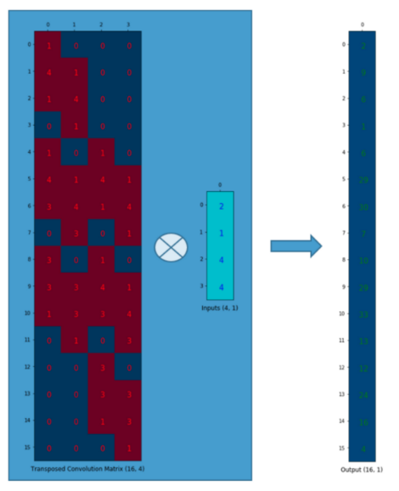
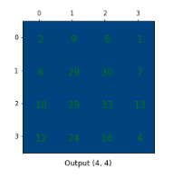
Transposed Convolution

Slide 28
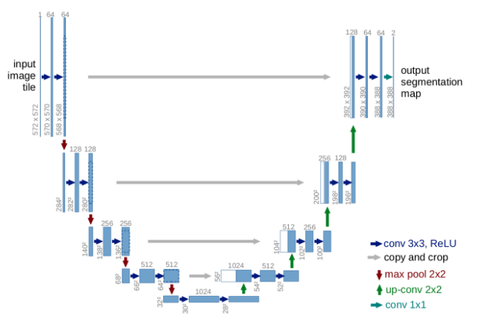
U-Net Architecture

Slide 29

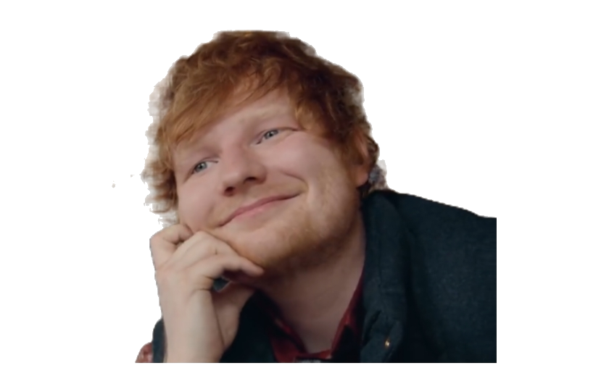
U-Net Architecture
I’m in love with the shape of U !!!

Slide 30
U-Net Architecture
Symmetric Architecture
Two main parts :
Contractive Path
Expansive Path
Contractive Path -> Downsampling
using max pooling.
Expansive Path -> Upsampling
using transposed convolution.

Slide 31
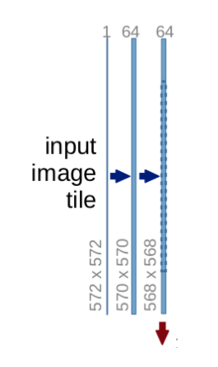
U-Net Architecture
Contractive Path
Conv_Layer → Conv_Layer → Max_Pooling_Layer → Dropout(optional)

Slide 32
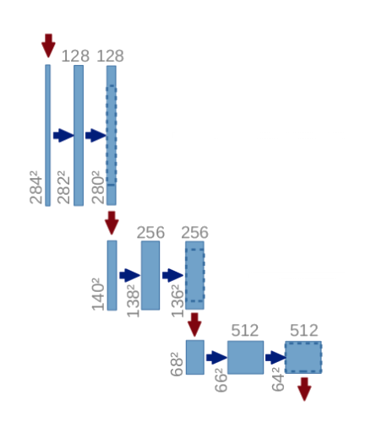
U-Net Architecture
Contractive Path
The basic process is repeated 3 more times
3x3 filters with ReLu activation function are used in convolutional layers.
2x2 max-pooling is applied with a stride of 2.
Output of the 2nd convolutional layer is stored at each step.

Slide 33
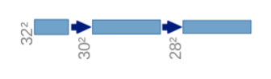
U-Net Architecture
The bottom most layer also has 2 convolutional layers.
No max-pooling is applied.
The output of 2nd convolutional layer is not stored and simply passed to the next(upper) layer.

Slide 34
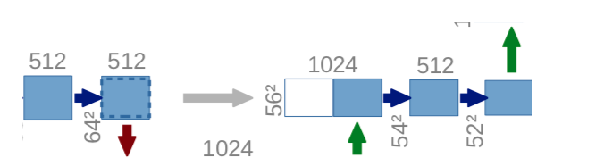
U-Net Architecture
Expansive Path
Transposed_Convolution → Copy_and_Crop → Conv_Layer → Conv_Layer → Dropout(optional)

Slide 35
U-Net Architecture
Expansive Path
The basic process is repeated same as in contraction path.
In the last layer, image segmentation map is obtained.

Slide 36
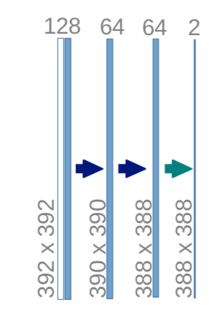
U-Net Architecture
The image segmentation map can be reshaped according to the prediction requirements.

Slide 37
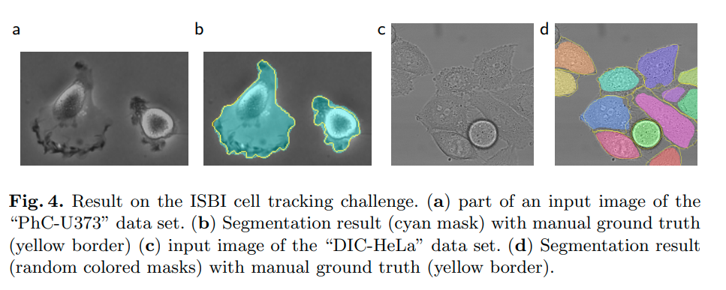
U-Net : Results

Slide 38
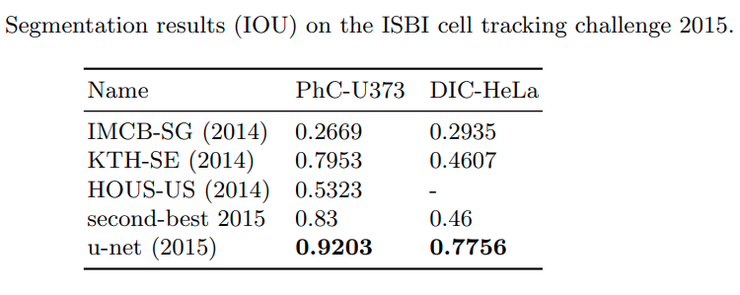
U-Net : Results

Slide 39
U-Net : Why does it work so well?
To get better precise locations, at every step of the decoder we use skip connections by concatenating the output of the transposed convolution layers with the feature maps from the Encoder at the same level.
Feature maps at different scales helps in capturing the fine local details as well as the global details.
After every concatenation we apply two consecutive regular convolutions so that the model can learn to assemble a more precise output.

Slide 40
U-Net : Limitations
Requires a good amount of memory for storing the intermediate feature maps.
Relies heavily on data augmentation.

Slide 41


